Slide 1
Combining the ensemble approach and the popular word vectorization/feature engineering techniques to improve the performance of the Sentiment Classifiers and evaluate the performance of the Classifiers with the change in the word vectorization technique-Sentiment Classification.
Shobhana Halapeti-LJMU MSC Data Science

Slide 2
Introduction
Sentiment Analysis is gaining popularity due to the enormous volume of the unstructured text produced through different social media platforms, e-commerce websites, blogs, online portals. Sentiment analysis enables the information extraction from this unstructured data, which in turn helps businesses to improve their products/services based on the customers' sentiments and helps the customers to know about the products before they buy. Sentiment Classification is an open research domain.
It has been noticed that the base classifiers do not perform significantly well due to the complexity involved in text data in terms of noise, volume. Most of the research papers have been cited where the base classifier is trained on the feature subset using the word vectorization/word embedding techniques like word2vec, TF-IDF, Bag of Words, or using the feature importance discretely. Efficient features selection techniques, word embedding, vector dimension reduction techniques are proven methods to improve the performance of the classifier significantly. Some research papers have also been cited where the Ensemble approach is used to improve the performance of the base classifiers.
The objective of this research is to use the combination of the most efficient word vectorization/word embedding techniques and the ensemble model to improve the performance of the base classifiers. The transition of the performance of the base classifiers and the ensemble model for sentiment classification is evaluated with the change in the word vectorization/embedding technique in the research.

Slide 3
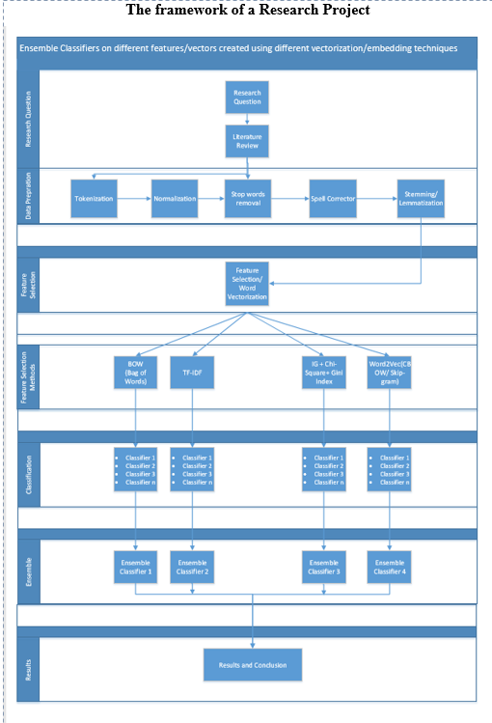
The Framework of a Research Project

Slide 4
Literature Review (Cont’d)
The below Literature review shows the importance of the Ensemble approach as well as feature extraction/ word vectorization techniques.
1] Xing Fang, Justin Zhan (2015)-Word vectorization Techniques like frequently occurring word tokens and phrase tokens (negation-of-adjective and negation-of-verb) – Xing Fang and Justin Zhan has processed both sentence-level categorization and review-level categorization with promising outcomes. The research is focused on reducing the variation of the words using Part of Speech tagging and, in turn, the effective features engineering or word vectorization techniques in order to optimize the performance of the classifier. Authors have used POS taggers to filter the words tagged as nouns and pronouns. In this work, there are two types of phrases that have been identified by the Authors, namely negation-of-adjective (NOA) and negation-of-verb (NOV). The authors have selected 11,478-word tokens with each of them that occurs at least 30 times throughout the dataset. For phrase tokens, namely negation-of-adjective (NOA) and negation-of-verb (NOV), 3,023 phrases were selected of the 21,586 identified sentiment phrases, where each of the 3,023 phrases also has an occurrence that is no less than 30. Here POS tags are used for features engineering. This approach has achieved an F1 score over 0.8 for the sentence level categorization and an F1 score of over 0.73 for review level categorization.
2] Monalisa Ghosh, Goutam Sanyal (2018)-Ensemble approach used to combine the top-ranked common Features – Monalisa Ghosh and Goutam Sanyal have investigated the ability of the widely used features selection methods ( IG, Chi-Square, Gini Index) individually as well as their combined approach on four machine learning algorithms. The authors have initially selected the features subset using three different feature selection methods. After that, the statistical method UNION, INTERSECTION, and revised UNION method are applied to merge these different feature subsets to obtain all top-ranked, including commonly selected features. Finally, the authors have trained the individual classifier SMO, MNB, RF, and LR (logistic regression) with these features vector for classification of the review data set. The performance of the algorithm is measured by evaluation methods such as precision, recall, F-measure, and ROC curve. Experimental results show that the combined method achieved the best accuracy of 92.31 with classifier SMO. Here, the authors have used the ensemble approach to combine the common top-ranked features extracted using IG, Chi-Square, and Gini Index techniques and trained the base classifiers on the combined features set.
3] Ankit, Nabizath Saleena (2018)-Ensemble Classifier combining the results of base classifiers to improve the accuracy-Ankit, Nabizath Saleena, have used the ensemble classifier combining the base classifiers Random Forest, SVM, Logistic Regression and Naïve Bayes to improve the accuracy for Twitter Sentiment Analysis. In this research study, the ensemble approach has not improved the accuracy significantly compared to the Base classifier. For the Twitter Sentiment Analysis, the accuracy is improved to 74.67%, whereas average accuracy for the base classifier is 72%. Here in this research, the Bag of Words technique is used for word vectorization.

Slide 5
Literature Review (Cont’d)
4] Jayakumar Sadhasivam, Ramesh Babu Kalivaradhan (2019)-Ensemble Classifier combining the results of base classifiers to improve the accuracy -Jayakumar Sadhasivam and Ramesh Babu Kalivaradhan has trained the ensemble classifier combining Support Vector Machine and Naïve Bayes classifiers on Amazon Products Review dataset. Here the ensemble classifier shows significant improvement in the accuracy (73% for Positives and 78% for Negatives) compared to base classifiers (Naïve Bayes- 32% Positives and 37% Negatives, SVM- 27% Positives and 33% Negatives).
5] Long Ma, Yanqing Zhang (2015)-Word2Vec to process big data text - Long Ma and Yanqing Zhang have emphasized on word2vec model for Big data processing. Processing a massive data set is time-consuming, not only due to the volume of data but also from different data types and intricate structures. Currently, many data mining and machine learning technologies are being applied to deal with big data problems. Authors have emphasized on the use of the word2vec algorithm, which is capable of selecting useful features and also reduce the feature dimension. Word2Vec, proposed and supported by Google, is not a special algorithm, but it consists of two learning models, Continuous Bag of Words (CBOW) and Skip-gram. By feeding text data into one of the learning models, Word2Vec outputs word vectors that can be represented as a large piece of text. In this paper, the authors first trained the data via the Word2Vec model and evaluated the word similarity. Also, they have clustered similar words together and use the generated clusters to fit into a new data dimension so that the data dimension is decreased. This research is focused on the use of the word2vec model for dimension reductions, especially for substantial data sets.
6] Devika M D, Sunitha C, Amal Ganesh (2016)-Sentiment Analysis: A Comparative Study on Different Approaches - Devika M D, Sunitha C, Amal Ganesh have emphasized on Sentiment analysis, requires the usage of a training set for performance optimization. They have mentioned that the quality of trained data plays a significant role in the accurate evaluation of the text. The semantic analysis of the sentence also increases the meaning and accuracy of the result. POS tagging is helpful to users for understanding whether the review or comment corresponds to the relevant subject searched for. This research is focused on the comparison and consolidation of the three main approaches used in sentiment analysis: 1) Machine Learning Approach 2) Rule-Based Approach 3) Lexicon Based Approach and shares the information of different machine learning classifiers in the form of advantages and disadvantages. Various sentiment analysis methods and different levels of analyzing sentiments have been studied in this paper. Machine learning methods like SVM, NB, Maximum Entropy methods were discussed here in brief, along with some other interesting methods that can improve the analysis process in one or the other way. Semantic analysis of the text is of great consideration. Research work is carried out for better analysis methods in this area, including the semantics by considering n-gram evaluation instead of word by word analysis.

Slide 6
Literature Review
7] Walaa Medhat, Ahmed Hassan, Hoda Korashy (2014)-Sentiment Analysis Algorithms and applications: A survey - Walaa Medhat, Ahmed Hassan, and Hoda Korashy have provided brief details on the various sentiment analysis techniques and the related fields. The main contributions of this paper include the sophisticated categorizations of a large number of recent articles and the illustration of the recent trend of research in the sentiment analysis and its related areas. Fifty-four of the recently published and cited articles are categorized and summarized. These articles give contributions to many SA related fields that use SA techniques for various real-world applications. With the help of briefing on recent research work on Sentiment Analysis in this paper, the below information is discovered.
Naïve Bayes and Support Vector Machines are the most frequently used ML algorithms for solving SC problems. They are considered a reference model where many proposed algorithms are compared to.
The interest in languages other than English in this field is growing.
The most common lexicon source used is WordNet, which exists in languages other than English. Building resources, used in SA tasks, is still needed for many natural languages.
Information from micro-blogs, blogs, and forums, as well as a news source, is widely used in SA recently. This media information plays a significant role in expressing people's feelings or opinions about a specific topic or product. Using social network sites and micro-blogging sites as a source of data still need more in-depth analysis.
There are some benchmark data sets, especially in reviews like IMDB, which are used for algorithm evaluation.
In many applications, it is essential to consider the context of the text and the user preferences. That is why more research is needed on context-based SA. Using TL techniques, related data to the domain can be used in question as training data. Using NLP tools to reinforce the SA process has attracted researchers recently and still needs some enhancements.

Slide 7
Problem Statement
It has been noticed in many research papers that the base classifiers do not perform significantly well due to the complexity involved in text data in terms of noise, volume.
There are research papers where the Ensemble model are built on the base classifiers to improve the performance of the base classifiers . These base classifiers are trained on a single feature subset /word vector.
There are research papers where feature engineering techniques like creating a common feature subset based on feature importance are used on different datasets to analyze the performance of the different base classifiers.
In many research papers, the Word2Vec technique (a shallow neural network) is tried to analyze the performance of the base classifier for the sentiment classification.
In many research papers, the ensemble model or the use of word vectorization/word embedding technique is cited as one of the approaches to improve the performance of the classifier for sentiment classification. However, these two popular approaches (ensemble model and the feature engineering) are not tried together.
In this research, the most popular word vectorization/word embedding techniques in combination with the ensemble approach are used to evaluate the significance of the change in the performance of the classifiers for each word vectorization technique.
The objective of the research is to evaluate whether change in the performance of the classifier is significant with the change in the word embedding/ feature selection approach.

Slide 8
Methodology (Cont’d)
The source of the data
Mobile Reviews data is scrapped from publicly available review websites Pricebaba and Mouthshut, using Beautiful Soup and urllib library. The scraped data is parsed from the HTML file to CSV format. There are 290967 rows and 14 columns in the data set. The main important columns considered for the analysis are Product, Review Updated, Rating, and Year.
Data Preparation
Reviews are classified as Positive (1) and Negative (0). The reviews having 1 Star and 2 Stars ratings are labeled to 0, i.e., Negative. Rating more than 2 Stars are labeled to 1, i.e., Positive. (Rating scale-1 to 5)
Data has 290967 rows. The data is filtered for the products which have at least 500 reviews and for the year 2016, 2017,2018.
Data is explored to have a general understanding of the data.
I have used the "text blob" library to understand the sentiment Polarity of the text. Polarity lies in the range of [-1,1] where 1 means a positive statement, and -1 means a negative statement. It is observed that average sentiment polarity is between 0.25 and 0.50 (high) for rating score “3”, “4”, and “5”. Average Sentiment Polarity for rating score “1” and “2” is between 0 and 0.25 (moderate).
Spacy Library is used for tokenization, Part of Speech tagging, and Lemmatization. The data preprocessing tasks are performed to get the required clean filtered data for sentiment classification.
Tokenization - documents/text is split into a List of Tokens/words.
Tokens with POS tags like AUX, NUM, SYM, ADP, PRON are removed as they do not add any value for the sentiment analysis.
Lemma for tokens is used for further analysis. Lemmatization is the process of transforming all the tokens into the original form. Lemmatization is based on POS tagging. Here tokens are converted to their lemma using the Spacy library to reduce the word variance.
Stop words are common and high-frequency words that do not add any information about the context. Hence, stop words are removed along with new lines, extra white leading/trailing spaces, Special Characters to reduce the word variation. Numeric text is also removed as they do not add any value to the Sentiment Analysis.
Data is divided into Train and test split (70 and 30% respectively)

Slide 9
Methodology
Features Selection/Word Vectorization
Text data is one of the most abundant sources of unstructured data. Text data usually consists of documents that can represent words, sentences, or even paragraphs of free-flowing text. The inherent unstructured and noisy nature of textual data makes it harder for machine learning algorithms to work on raw text data directly. Hence, the text data is converted to a one-hot encoded form that machines can understand and learn.
In this research, multiple techniques like Bag of Words, TF-IDF, Chi-Square, Gini Index, and Information Gain are used for Features Engineering/selection/word vectorization. Word2Vec vectorization from genism model is also used as one of the word vectorization technique. CBOW architecture of Word2Vec is used for word embedding in this research.
The CBOW (Continuous Bag of Words) model predicts the current word given context words within a specific window. The input layer contains the context words, and the output layer contains the current word. The hidden layer contains the number of dimensions in which we want to represent the current word present at the output layer
Classification
Machine learning techniques are widely used in artificial intelligence and document classification. Extracted feature sets are used to train the classifier to classify the reviews as positive or negative.
In this research, the Naïve Bayes, Logistic Regression, Decision Tree, and Support Vector classifiers are trained on Mobile Review dataset for each feature subset created using the mentioned word vectorization/ embedding techniques.
The stability of each base classifier is evaluated using a 3-fold Cross-Validation technique. Weights are applied on base classifiers to build the ensemble model based on the stability factor and the performance of the base classifier. The ensemble model is built by applying weighted majority voting on the base classifiers for each feature subset.
Model Evaluation:
Models/Classifiers developed on each feature subset is evaluated based on three parameters: 1) Stability, 2) Accuracy (Ability of model to classify correctly, 3) F-Measure- which describes the ability of the model to classify the relevant class.

Slide 10
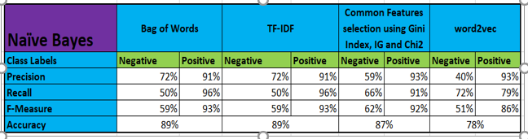
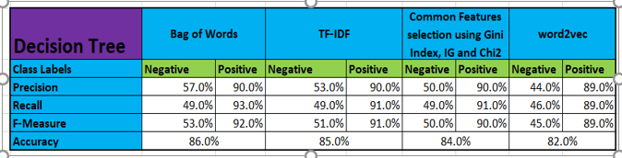
Results (Cont’d)
Naive Bayes (NB)
The average accuracy of the Naïve Bayes classifier across all feature subsets is 85%.
The Naïve Bayes classifier performance is low in the case of the prediction of negative sentiments. The average precision and recall for Naïve Bayes classifier with respect to negative sentiments classification across all feature subsets is 61 and 60%, respectively.
Decision Tree
The average accuracy of the Decision Tree classifier across all word vectors/feature subsets is 84.3%.
The Decision Tree classifier performance is low for the classification of the negative sentiments. The average recall and precision for the Decision Tree classifier with respect to negative sentiment classification across all word vectors is 48.3% and 51%, respectively.

Slide 11
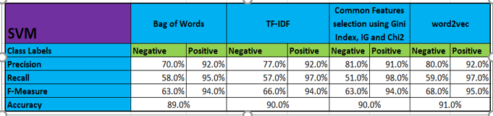
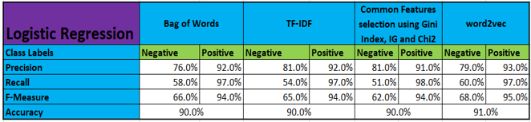
Results (Cont’d)
Support Vector Machine (SVM)
The average accuracy of the Linear SVM classifier across all word vectors/feature subsets is 90%.
The Linear SVM classifier performance is low for the classification of the negative sentiments. The average recall for the Linear SVM classifier with respect to the negative sentiments classification across all word vectors is 56.3%.
Recall for SVM is improved to 59% for negative sentiments classification with the word2vec vector.
Logistic Regression
The average accuracy of the Logistic classifier across all word vectors/feature subsets is 90.3%.
The Logistic classifier performance is low for the classification of the negative sentiments. The average recall of the Logistic classifier for negative sentiments classification across all word vectors is 55.8%.
Recall for the Logistic Regression is improved to 60% for negative sentiments classification with the Word2Vec vector.

Slide 12
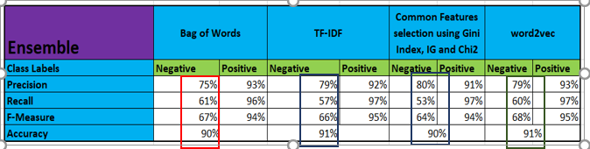
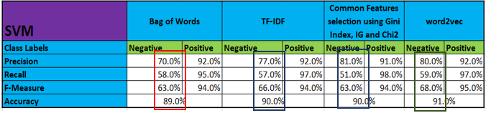
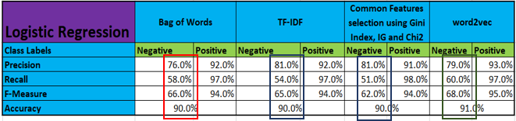
Results
Ensemble Model
The average accuracy of the Ensemble classifier across all feature subsets is 91%.
The Ensemble classifier performance is improved for the classification of the negative sentiments in comparison to the base classifiers. The average recall for the Ensemble Classifier for negative sentiments classification across all word vectors is 58%, whereas the average recall for the strong learners like the Logistic Regression and the Support Vector classifier is 55.8 and 56.3% respectively.
Ensemble Classifier, which combines the results of the weak and the strong learners, has improved the F-Measure for negative sentiments classification compared to the strong learners across all feature subsets.
You also see the improvement in the results of the ensemble classifier with the change in feature subsets. Ensemble Classifier performs better for word2vec compared to other word embeddings/vectorization techniques.

Slide 13
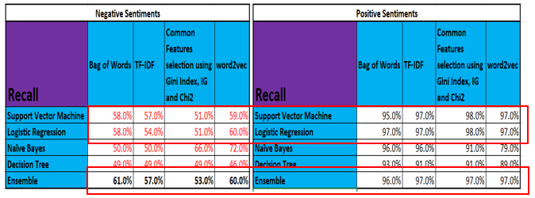
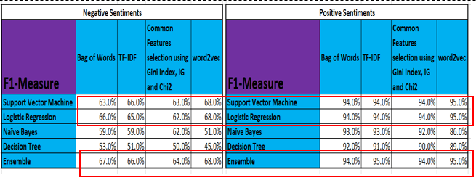
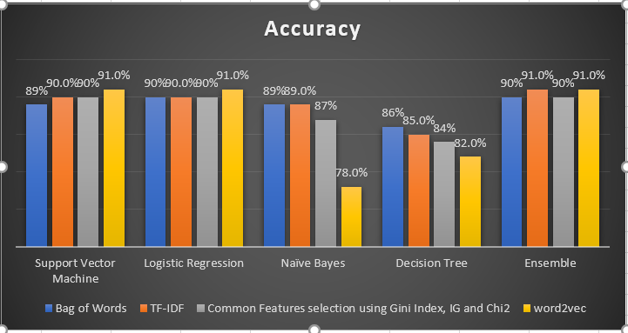
Result Summary
The logistic and the Support Vector classifier (Strong learners):
The logistic and the Support Vector classifier are the strong learners compared to the Decision tree and the Naïve Bayes classifiers.
The logistic and the Support Vector classifiers are low on recall measure for negative sentiments classification across all feature subsets. However, the recall of the logistics and SVM classifier is improved to 60% and 59% respectively for word2vec compared to Bag of Words (58% both), TF-IDF (LR-54% and SVM-57%) and the feature selection based on feature importance (LR-51% and SVM-51%).
The F-Measure of the logistics and SVM Classifier is improved to 68% (both) for word2vec compared to Bag of Words (LR-66% and SVM-63%), TF-IDF (LR-65% and SVM- 66%), and the feature subset created based on feature importance (LR-62% and SVM-63%).
The Ensemble Classifier:
The recall of the ensemble Classifier for negative classification is improved significantly for each feature subset (Bag of Words-61%, TF-IDF-57%, the feature subset based on features importance-53% and Word2Vec-60%) compared to the strong learner - the Logistic Classifier. The recall of the Logistic classifier for negative classification is 58% for Bag of Words, 54% for TF-IDF vector, 51% for feature selection based on features importance, and 59% for the word2vec vector.
As a result, you see the improved accuracy of the Ensemble model for each feature subset compared to the base classifiers.

Slide 14
Conclusion and Future work (Cont’d
There are research papers where the Ensemble model is built on the base classifiers. These base classifiers are trained on a single feature subset to improve the performance of the sentiment classification. There are research papers where a common feature subset based on feature importance are used on different datasets to analyse the performance of the different base classifiers. In many research papers, the Word2Vec technique is tried to analyse the performance of the base classifier for the sentiment classification.
In this research, the combination of the ensemble model and the different popular word vectorization/embedding techniques are tried to evaluate the significance of the change in performance of sentiment classification with the change in feature extraction techniques.
It is observed that there is an improvement in overall performance of the strong classifiers with word2vec vector compared to the other feature subsets. As observed, there is a significant improvement in the negative sentiment classification (recall) with the combination of the strong base learners and the Word2Vec-word vectorization technique.

Slide 15
Conclusion and Future work
The accuracy of the ensemble classifier is in line with the accuracy of the strong classifier. In contrast, there is further improvement in the recall for negative sentiments classification of the ensemble classifier compared to the strong base learner -the Logistic Regression.
It is observed that there is a significant improvement on the low performance parameters of the strong base classifiers with the change in the word vectorization technique Word2Vec. There is also the improvement in the low performance parameters of the base classifiers with the shift to the ensemble model. The combination of the word2vec model and the ensemble model shows the best performance parameters for the sentiment classification on top of the combination of the other word vectorization techniques with the classifiers.
However, the improvement in the performance of the sentiment classifier is not significant with the change to the word2vec vector and the ensemble approach.
The performance parameters where the strong classifiers are weak, are found to be improving with the use of the ensemble approach and the change to Word2Vec model. The performance of the combination of Ensemble model and word2vec vector is on top of the different other combinations between the ensemble model and other feature subsets. However, as future work, the Deep Learning applications can be implemented to see whether the performance improves significantly compared to the performance of the word2vec model and the ensemble approach combined as used in this research paper.

